Slide 1
Deformation Gradient Control In the Material Point Method
Michael Xu
MOTOGRAPH 2019

Slide 2
Problem Statement
Control the shape of amorphous objects through physical simulation
More specifically:
Given a physical object and a target shape, how can we control the deformation of the object to match the target shape in a physical environment using only internal forces?

Slide 3
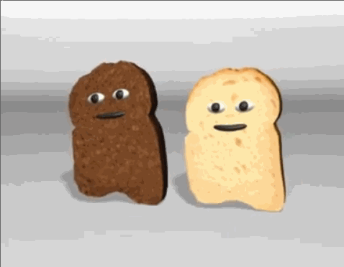
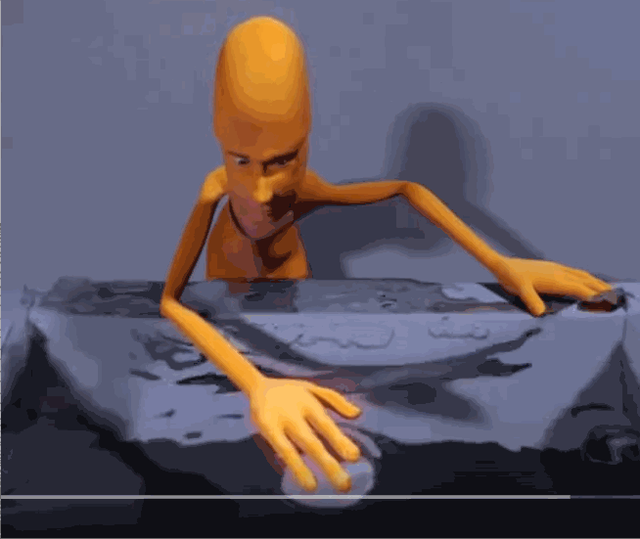
Related WORK (Control)
Fluid Control Using the Adjoint Method (2004)
Deformable Objects Alive! (2012)
Blender Magic Fluids (2005, YouTube)

Slide 4

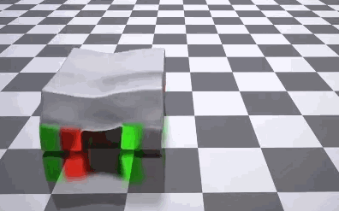
Related Work (MPM)
A Material Point Method For Snow Simulation (2013)
ChainQueen: A Real-Time Differential Physical Simulator for Soft Robotics (2018)
Introduction of MPM to graphics
Controlling a soft robotic with actuators (stress-based control)

Slide 5
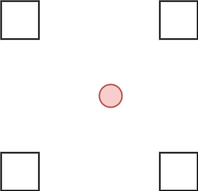
MPM BASICs
Particles carry physical and material properties
Particles need some way of affecting each others' dynamics (like “intermolecular forces”)
Grids are computational scratchpads that approximate the “intermolecular forces”

Slide 6
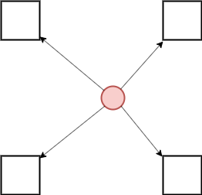
Particle to Grid (P2G)
Particles project mass, momentum, and internal forces onto the grid

Slide 7
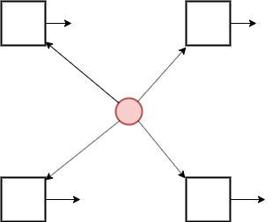
Grid Update (G)
Grid calculate current velocity from momentum / mass, then updates velocity from external and internal forces

Slide 8
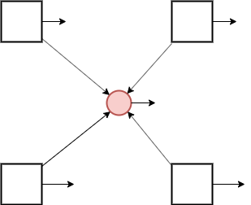
Grid To Particle (G2P)
Grid projects velocity onto particles, and updates particle deformation gradient

Slide 9
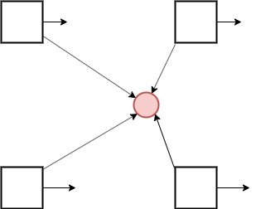
Particle Update (P)
Particle moves in direction of new velocity

Slide 10
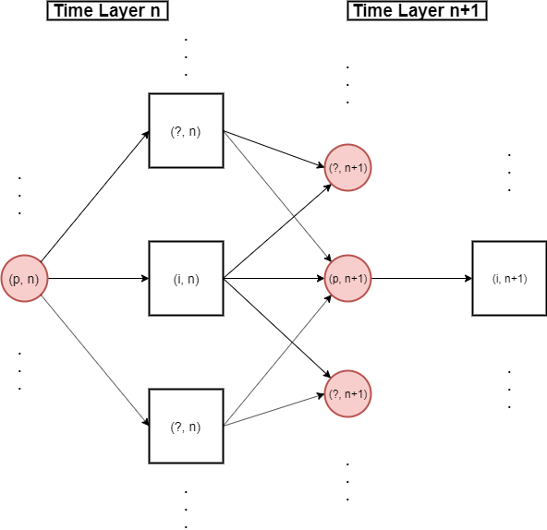
Physical Simulations are Computation Graphs

Slide 11
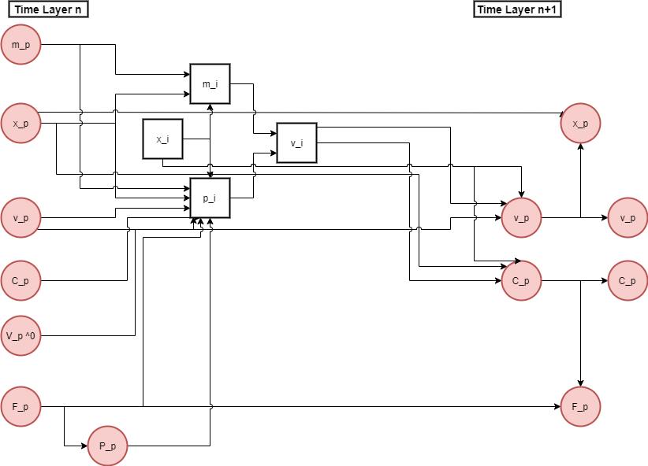
The computation graph between one particle and on grid node

Slide 12
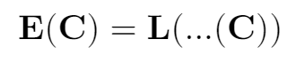
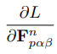
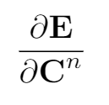
Let ‘C’ denote the tensor of control deformation gradients
We define energy/loss functions as:
Thanks chainqueen, and chain rule
Descend in these directions

Slide 13
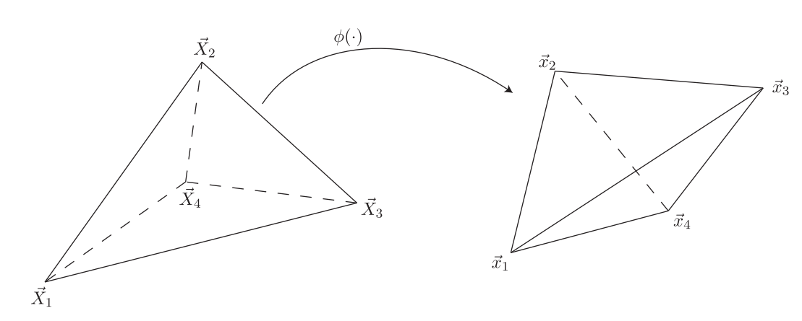
Deformation Gradients IN FEM
Are calculated from a reference tetrahedral mesh
From Siggraph 2012 FEM course notes

Slide 14
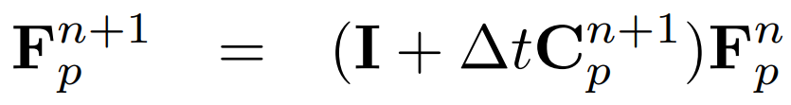
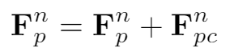
Deformation Gradients in MPM
Are incrementally calculated by this formula (MLS-MPM specifically)
What if we added an extra control deformation gradient?

Slide 15
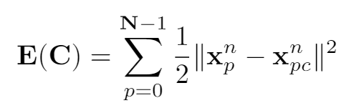
Deformation Gradient Control (Position Loss function)
C: tensor of control variables (deformation gradients in our case)

Slide 16
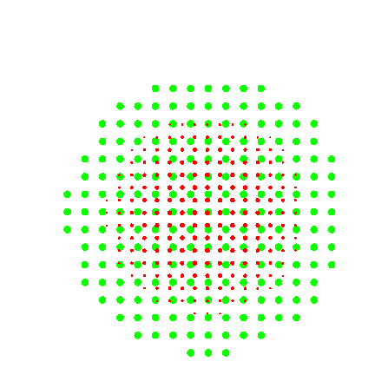



Slide 17
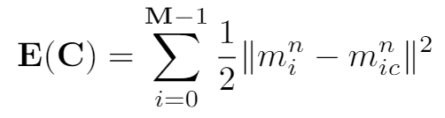
Deformation Gradient Control (Grid-Mass Loss Function)

Slide 18
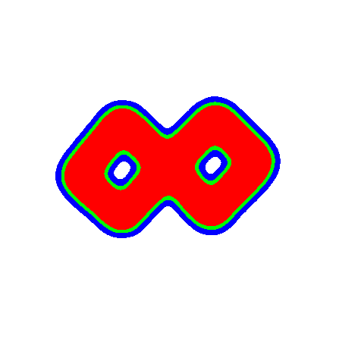
Topology Change

Slide 19
Thank YOU!

